Slide 1





Module 6: GSEA Lecture BIOM262
Feb 11-13 2020
Pablo Tamayo
Director, UCSD Center for Cancer Target Discovery and Development (CTD2)
Head, Computational Cancer Analysis Laboratory (CCAL)
Co-Leader, California Initiative to Advance Precision Medicine UCSD project.
Co-Director, Genomics and Computational Biology Shared Resource (GCBSR)
Professor, Division of Medical Genetics, UC San Diego School of Medicine
Visiting Scientist, Cancer Program, Broad Institute of MIT/Harvard
William Kim
Co-Director, UCSD Center for Cancer Target Discovery and Development (CTD2)
Member, Computational Cancer Analysis Laboratory (CCAL)
Co-Leader, California Initiative to Advance Precision Medicine UCSD project.
Assistant Professor, Division of Medical Genetics, UC San Diego School of Medicine
Visiting Scientist, Cancer Program, Broad Institute of MIT/Harvard
Anthony Castanza
Curator, Molecular Signatures Database
Mesirov Lab, Department of Medicine
University of California, San Diego
Michael Reich
Assistant Director of Bioinformatics
Mesirov Lab, Department of Medicine
University of California, San Diego

Slide 2
Objectives of this Module
Learn the Basics of Gene Set Enrichment Analysis (GSEA) (P. Tamayo)
History and Background
Algorithm / Statistical Test / Method
Modalities of Use
Develop Hands-on Experience with a GSEA Prototype in Jupyter (P. Tamayo)
Examples of Applying GSEA to Address Questions in Biomedical Research.
(W. Kim)
Develop a Sense for Common Pitfalls, Challenges and Limitations of GSEA Analysis (W. Kim)
Overview of the Molecular Signatures Database (A. Castanza, Mesirov Lab)
Get Introduced to the Production Version of GSEA (M. Reich, Mesirov Lab)

Slide 3

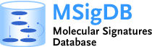











The GSEA /MSigDB Team at UCSD and the Broad Institute
www.gsea-msigdb.org
Jill Mesirov
Professor
UCSD School of Medicine
Michael Reich
Assistant Director of Bioinformatics UCSD
Helga Thorvaldsdottir
GSEA Project manager
Broad Institute
William Kim
Assistant Professor
UCSD School of Medicine
Kwat Yeerna
Sr. Research Data Scientist
UCSD
Anthony Castanza
Curator
Molecular Signatures Database
UCSD
Jack Niklason
Research Data Scientist
UCSD
David Eby
Sr. Software Engineer
Broad Institute
Xiaodong (Max) Xu
Sr. Research Data Scientist
UCSD

Slide 4
History and Background

Slide 5

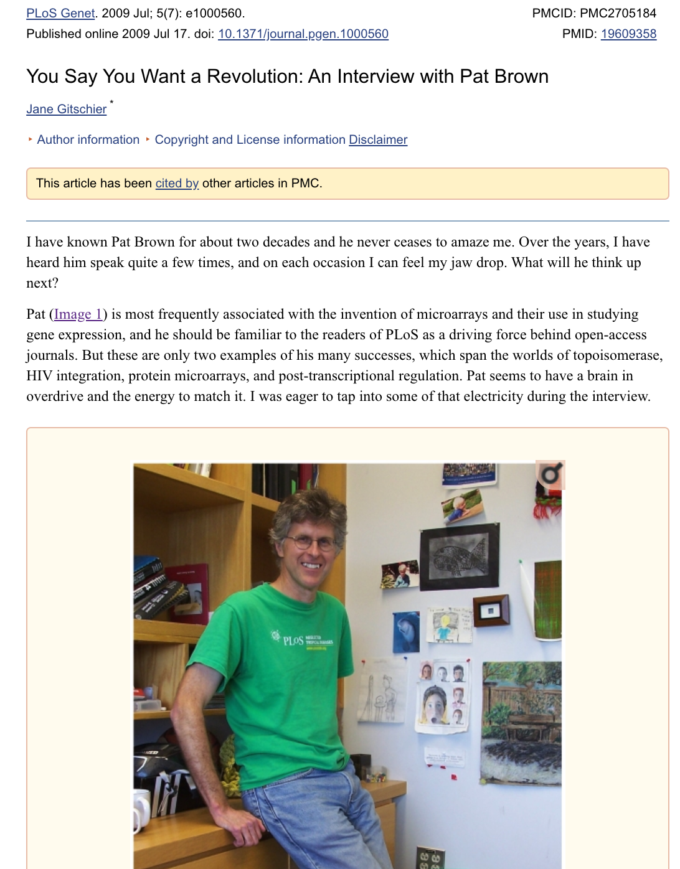
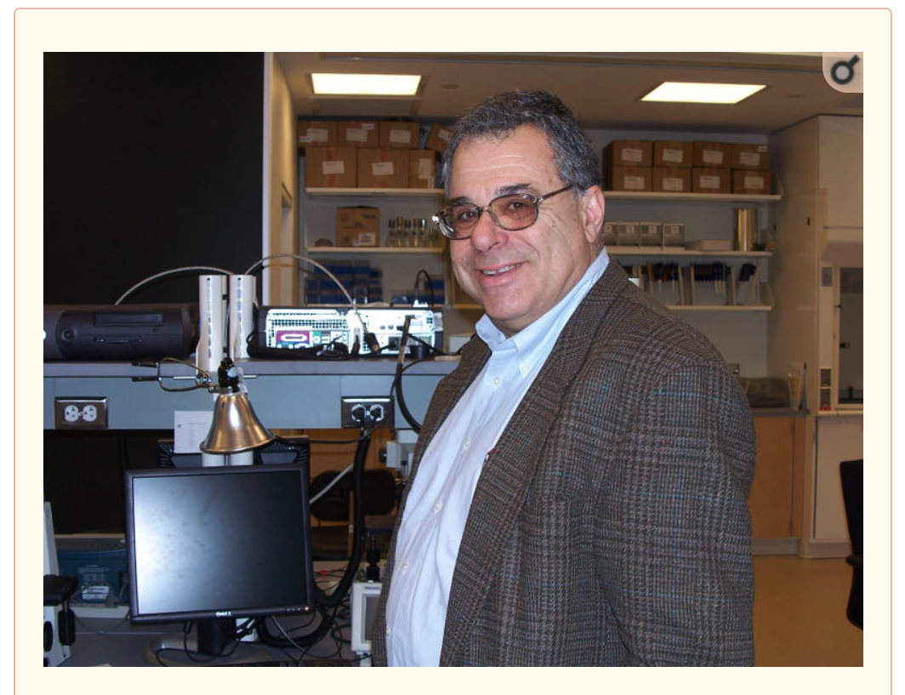

The Sequencing of the Human Genome and the First Use of Gene Expression Microarrays
Pat Brown
David Botstein
Eric Lander

Slide 6
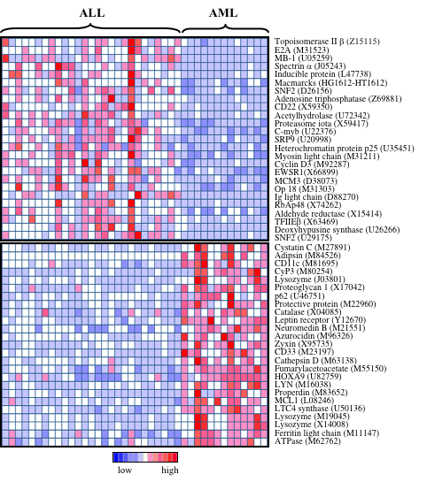
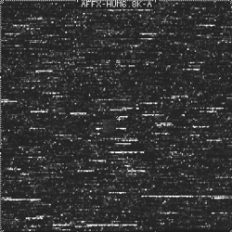
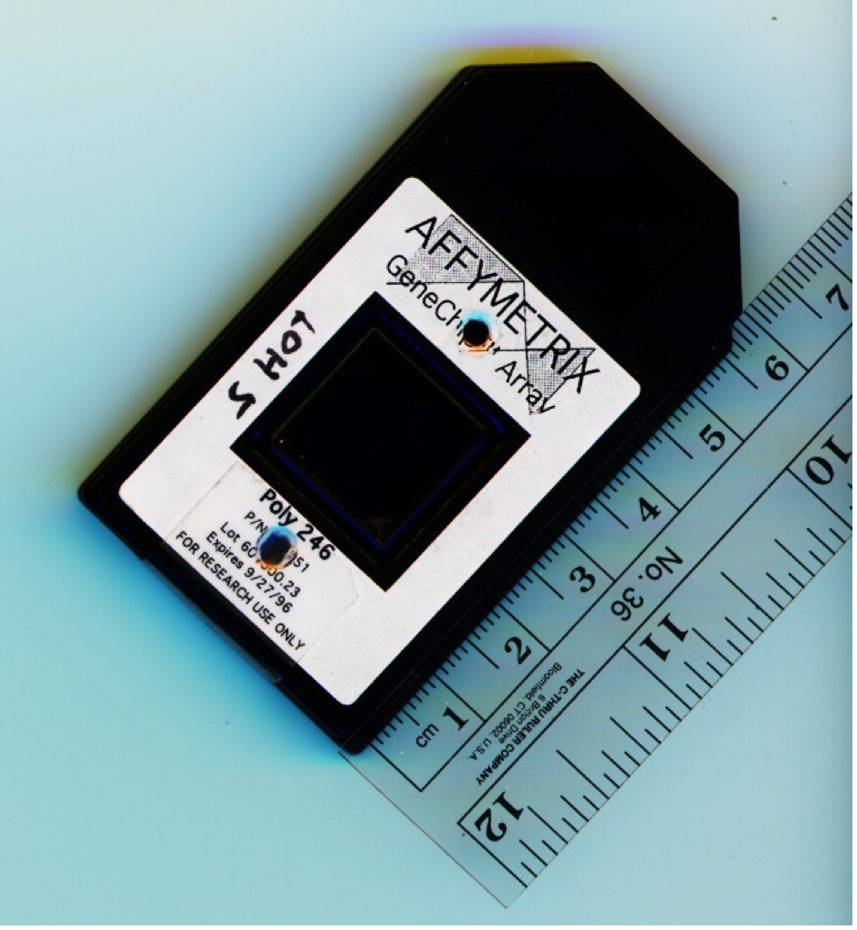

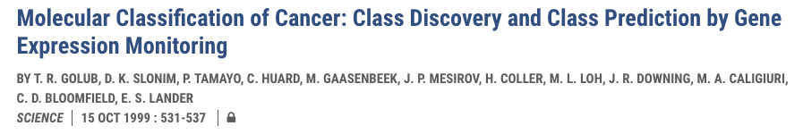
Differential Gene Expression Analysis (circa 1999)

Slide 7
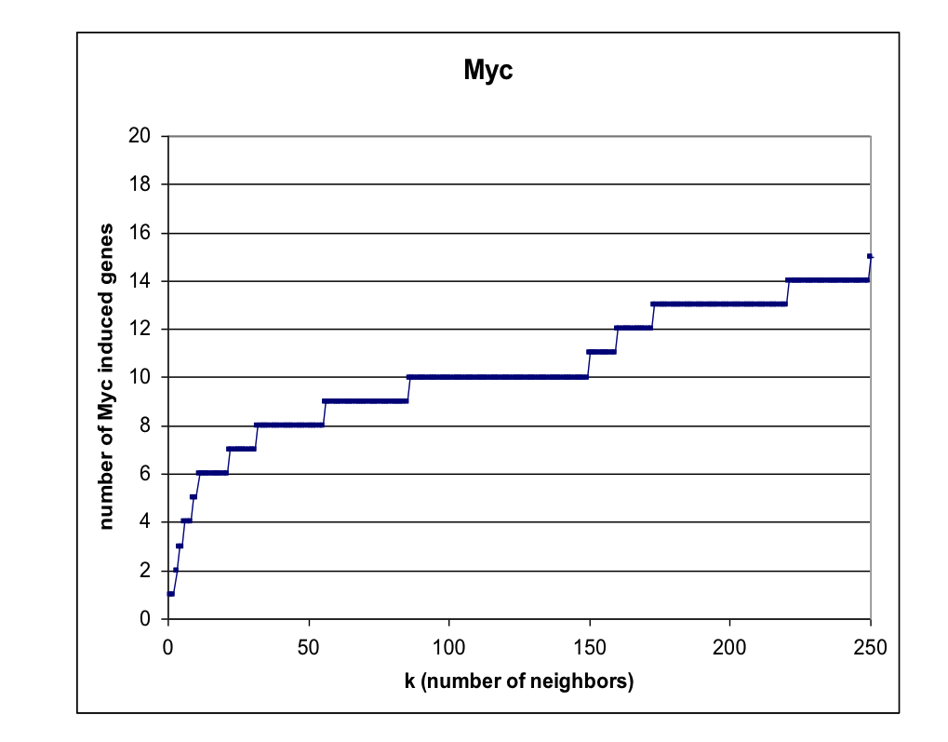
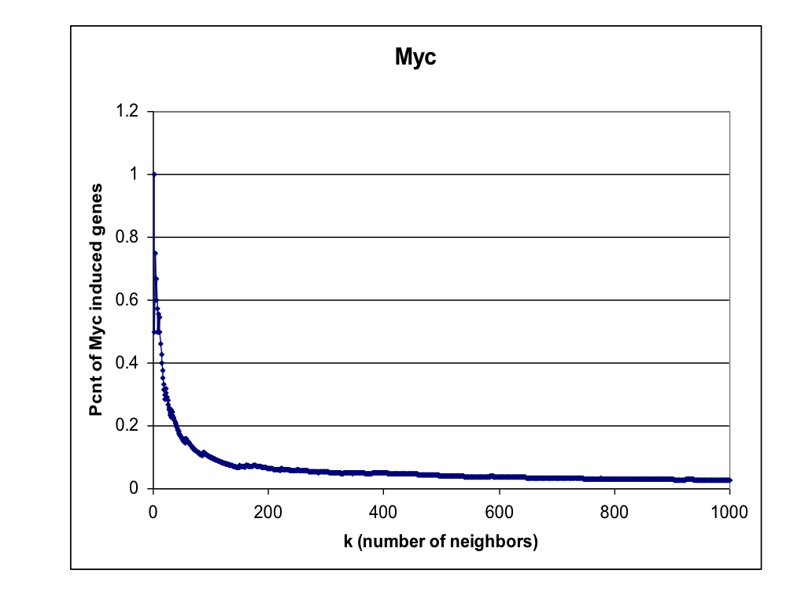
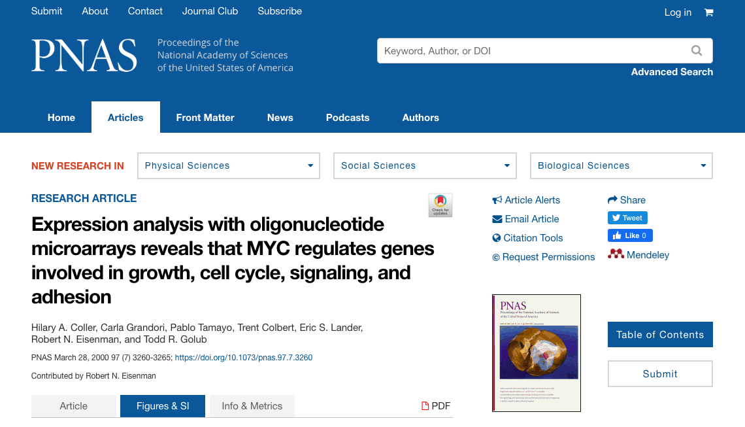
GSEA Before GSEA (December 1998)
k-Nearest Neighbor Analysis of Gene Expression Data

Slide 8
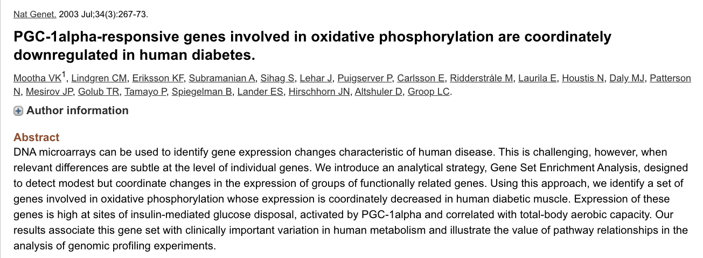
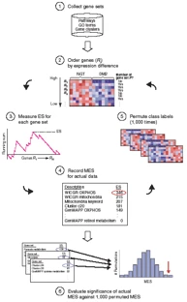


Vamsi Mootha Nick Patterson

Slide 9
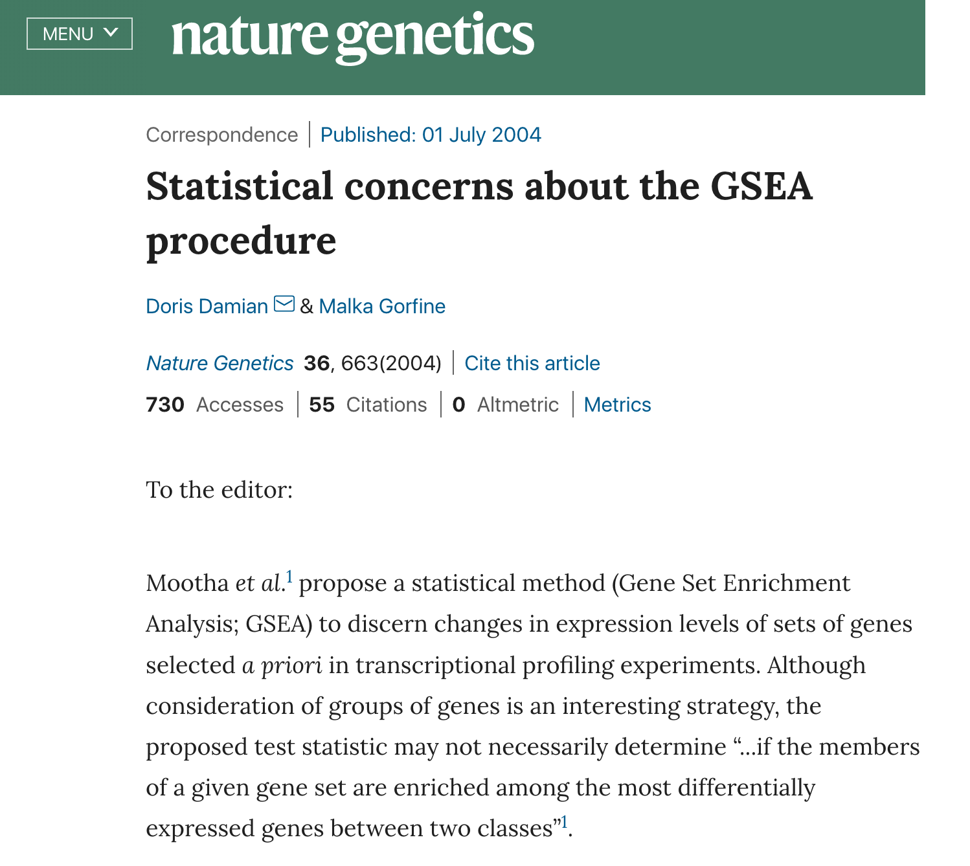

Slide 10
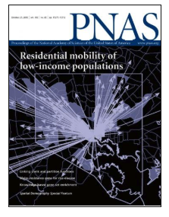
The Standard GSEA
We recently developed a method called Gene Set Enrichment Analysis (GSEA) that evaluates microarray data at the level of gene sets. The gene sets are defined based on prior biological knowledge, e.g., published information about biochemical pathways or coexpression in previous experiments. The goal of GSEA is to determine whether members of a gene set tend to occur toward the top (or bottom) of a gene list in which case the gene set is correlated with the phenotypic class distinction.
Subramanian A, Tamayo P, Mootha VK, Mukherjee S, Ebert BL, Gillette MA, Paulovich A, Pomeroy SL, Golub TR, Lander ES, Mesirov JP. Gene set enrichment analysis: a knowledge-based approach for interpreting genome-wide expression profiles. Proc Natl Acad Sci U S A. 2005 Oct 25;102(43):15545-50.

Slide 11
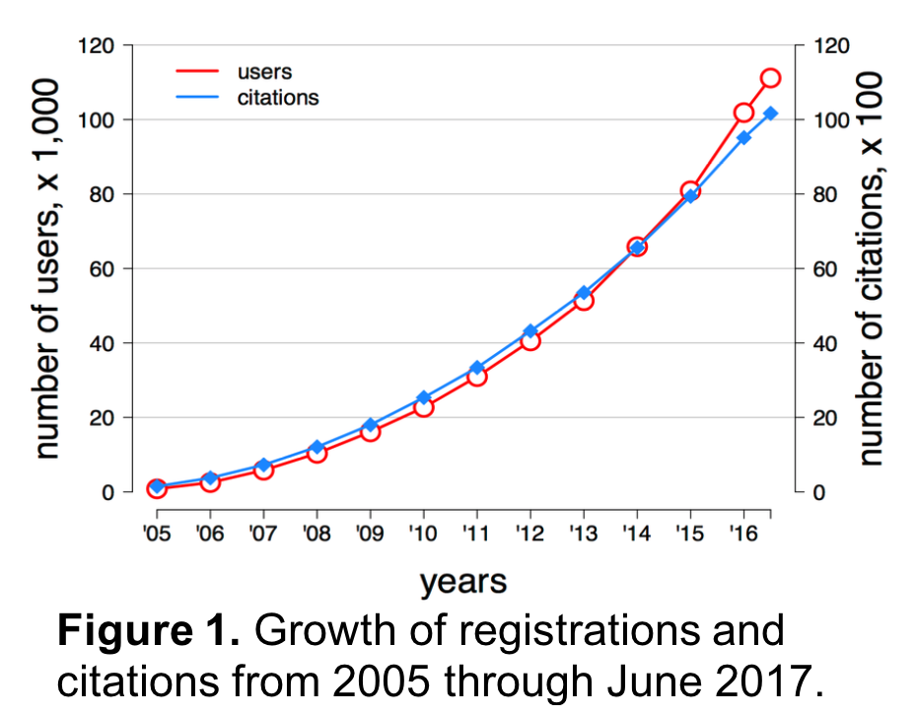

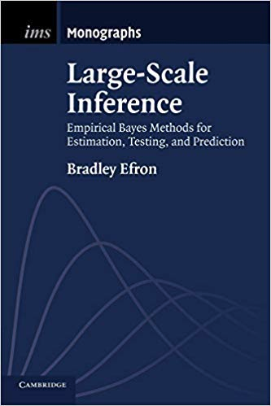
Since its release in 2005 GSEA/MSigDB have registered over 100,000 users worldwide and have been cited in over 10,000 papers

Slide 12
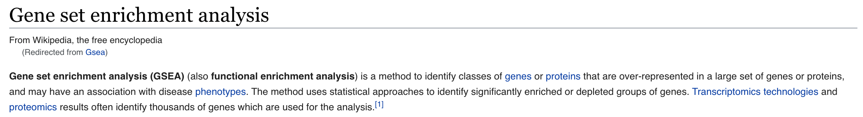
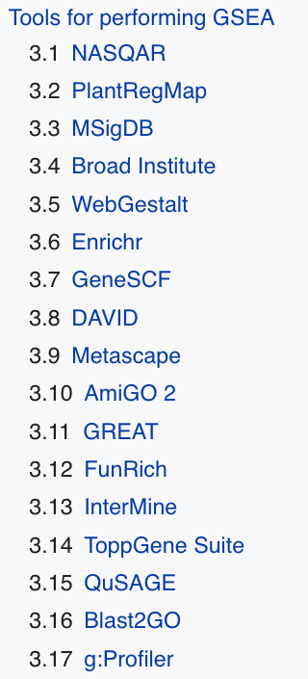

Slide 13
Algorithm / Statistical Test / Method

Slide 14
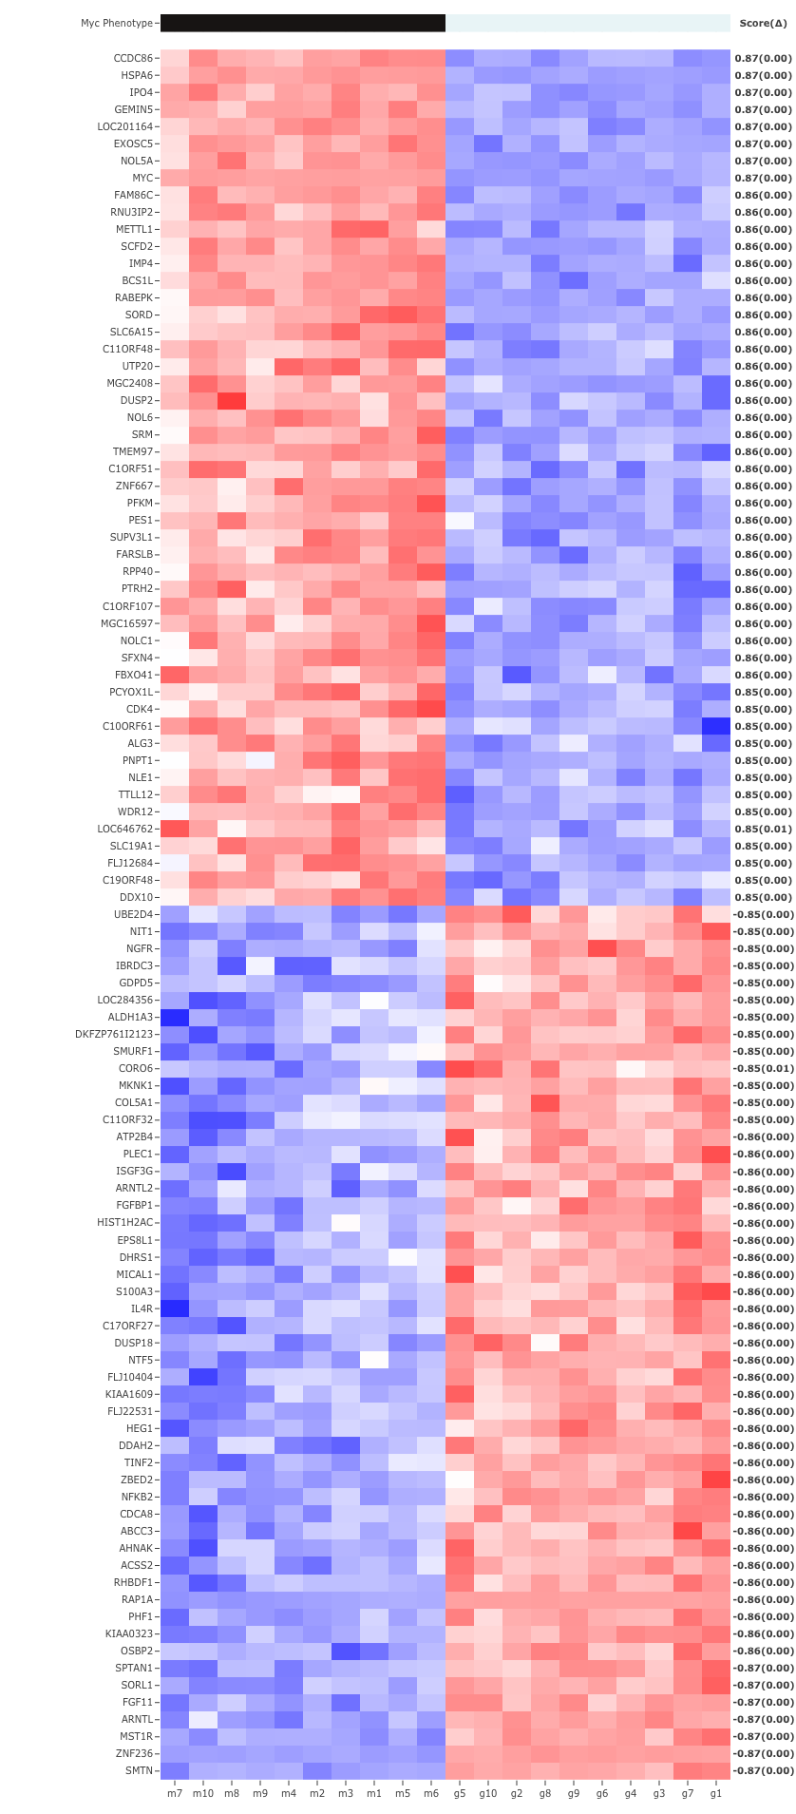



DGE Analysis: Overexpression of the MYC Oncogene
Set of Top 50 Differentially Expressed Genes between control cell lines and over-expression of the MYC oncogene
MYC
Targets of MYC?
Bild AH, Yao G, Chang JT, Wang Q, Potti A, Chasse D, Joshi MB, Harpole D, Lancaster JM, Berchuck A, Olson JA Jr, Marks JR, Dressman HK, West M, Nevins JR. Oncogenic pathway signatures in human cancers as a guide to targeted therapies.
Nature. 2006 Jan 19;439(7074):353-7.
Andrea Bild Joseph R. Nevins

Slide 15
GSEA was Developed Because of a Need to Better Interpret Differential Gene Expression Results
A common approach involves focusing on a handful of genes at the top and bottom of the gene list (i.e., those showing the largest difference) to discern telltale biological clues. This approach has a few major limitations.
(i) After correcting for multiple hypotheses testing, no individual gene may meet the threshold for statistical significance, because the relevant biological differences are modest relative to the noise.
(ii) Alternatively, one may be left with a long list of statistically significant genes without any unifying biological theme. Interpretation can be daunting and ad hoc, being dependent on a biologist's area of expertise and the urge to get a manuscript or grant proposal completed.
(iii) Single-gene analysis may miss important effects on pathways. Cellular processes often affect sets of genes acting in concert. An increase of 20% in all genes encoding members of a metabolic pathway may dramatically alter the flux through the pathway and may be more important than a 20-fold increase in a single gene.
(iv) When different groups study the same biological system, the list of statistically significant genes from the two studies may show distressingly little overlap.
Adapted from Subramanian A, Tamayo P, Mootha VK, Mukherjee S, Ebert BL, Gillette MA, Paulovich A, Pomeroy SL, Golub TR, Lander ES, Mesirov JP. Gene set enrichment analysis: a knowledge-based approach for interpreting genome-wide expression profiles. Proc Natl Acad Sci U S A. 2005 Oct 25;102(43):15545-50.

Slide 16
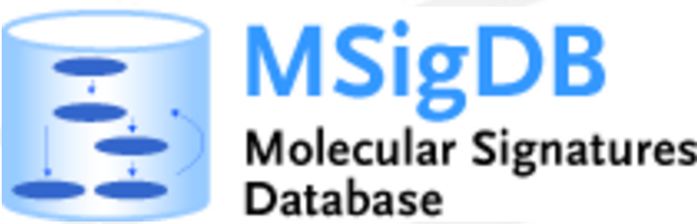
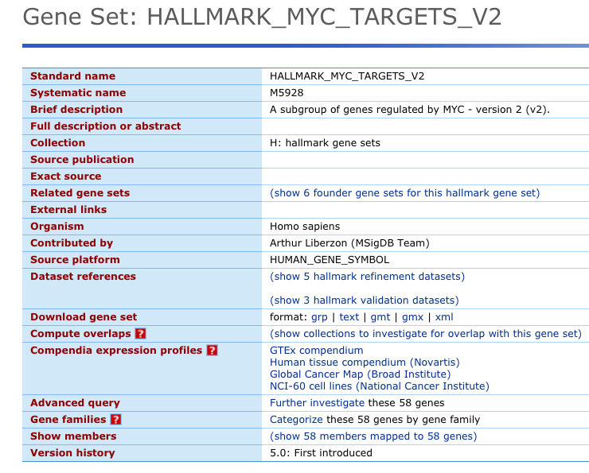
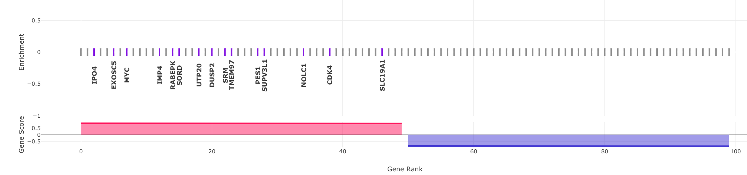
Interpret DGE Analysis Results using known sets of genes associated with e.g. MYC activation
Gene Set Gene List Gene Score

Slide 17
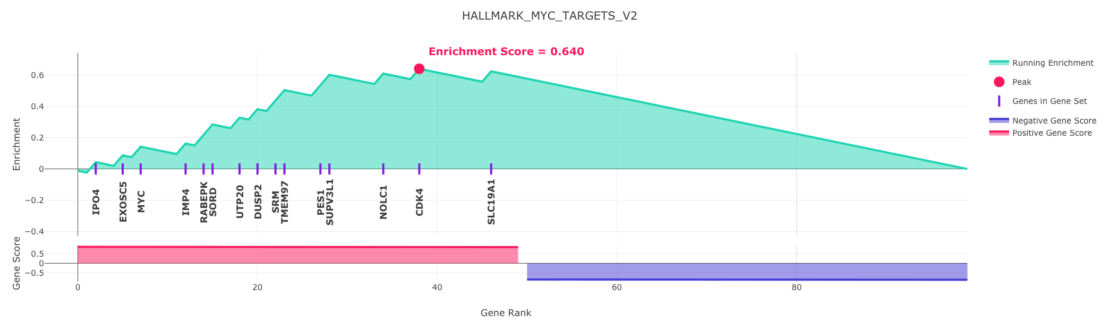
Core GSEA Enrichment Procedure
Gene Set Gene List / Score
IPO4
EXOSC5
MYC
IMP4
RABEPK
SORD
UTP20
DUSP2
SRM
TMEM97
PES1
SUPV3L1
NOLC1
CDK4
SLC19A1
Inputs:
Gene Set Gene List + Gene Score
GSEA
Enrichment
Enrichment Score: 0.640
Enrichment Plot
Outputs:

Slide 18
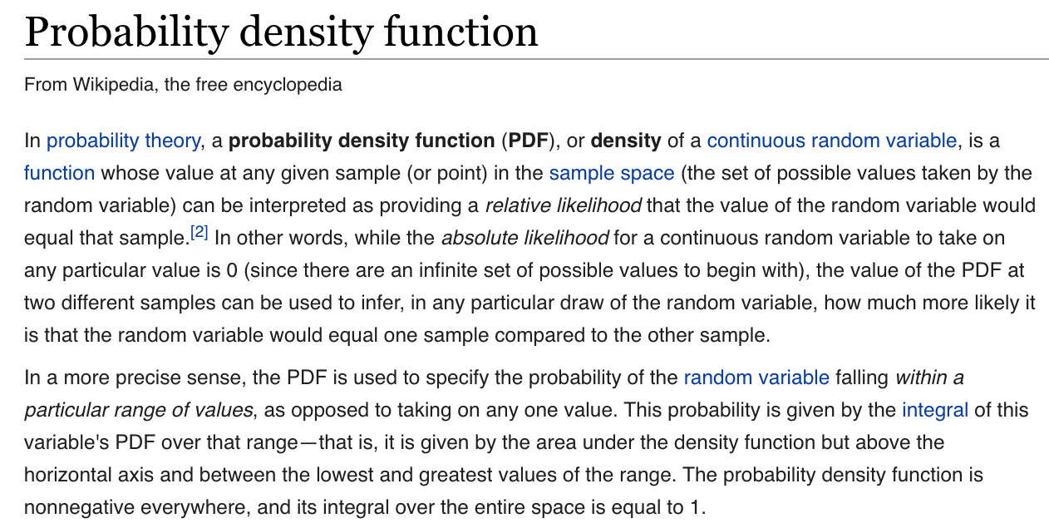
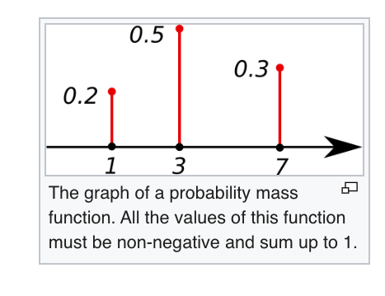
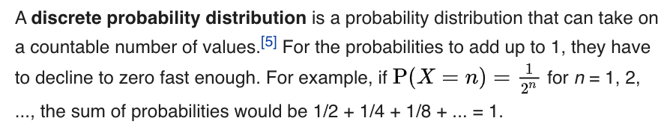

Slide 19
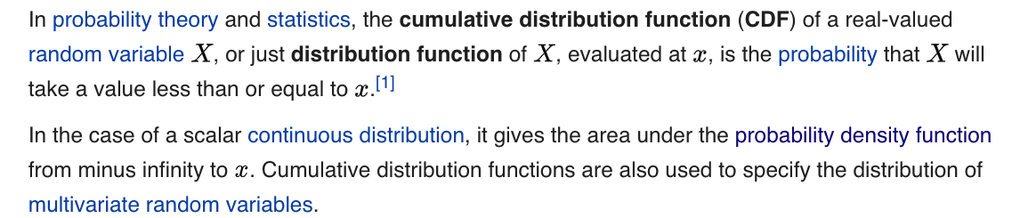
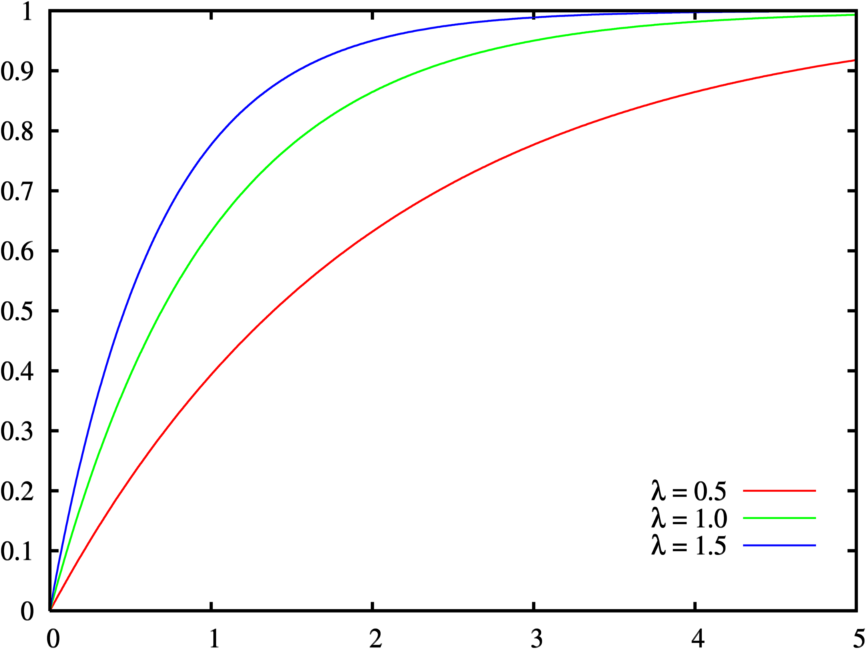
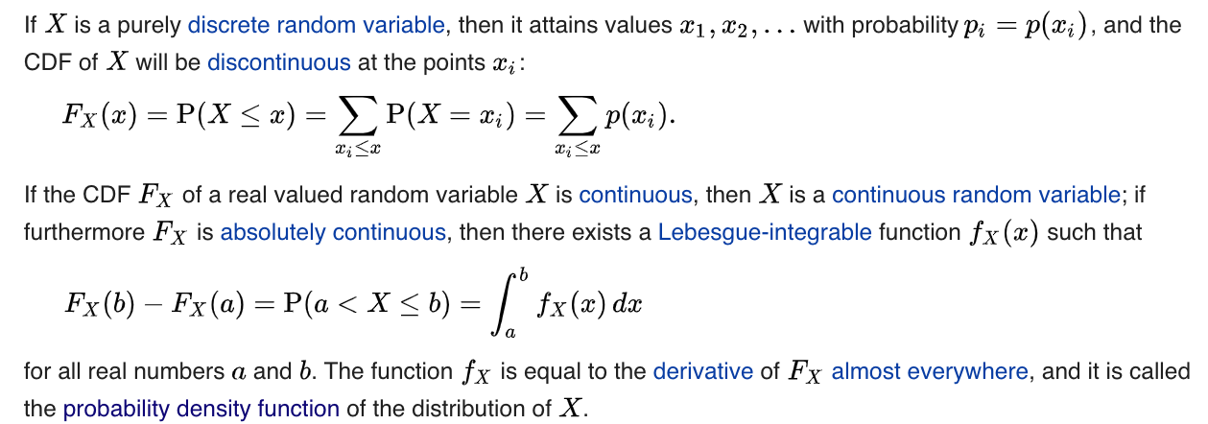

Slide 20
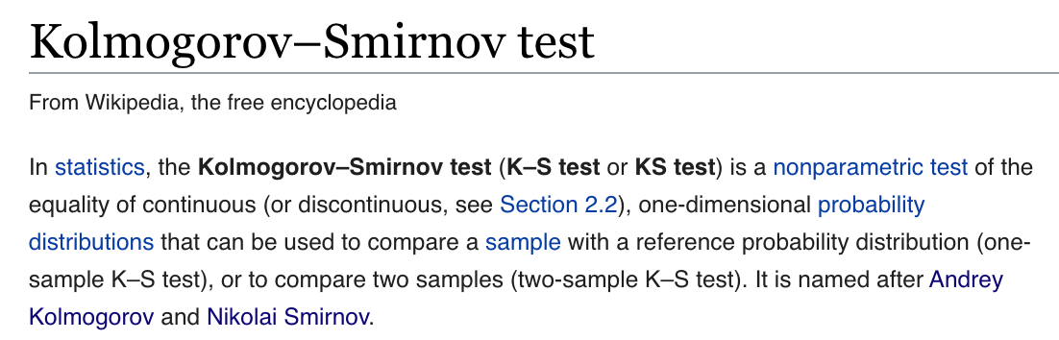
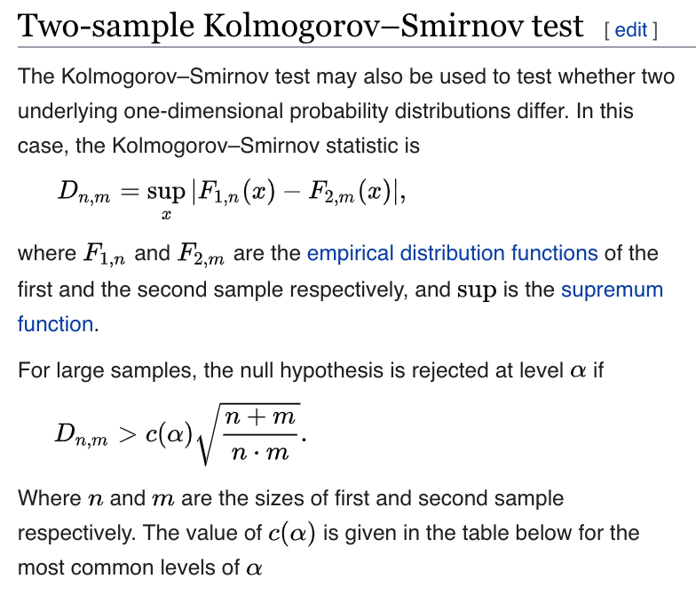
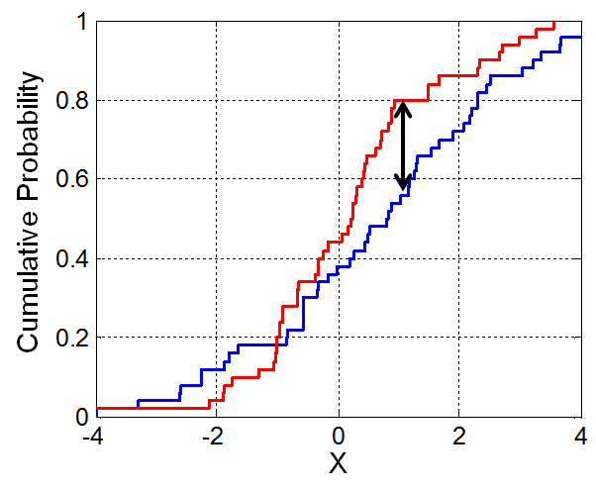

Slide 21
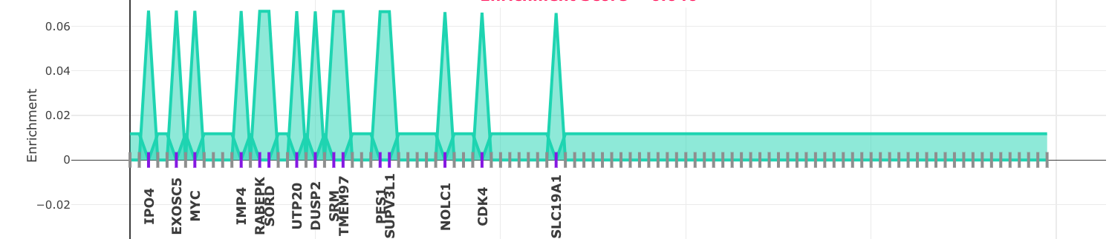
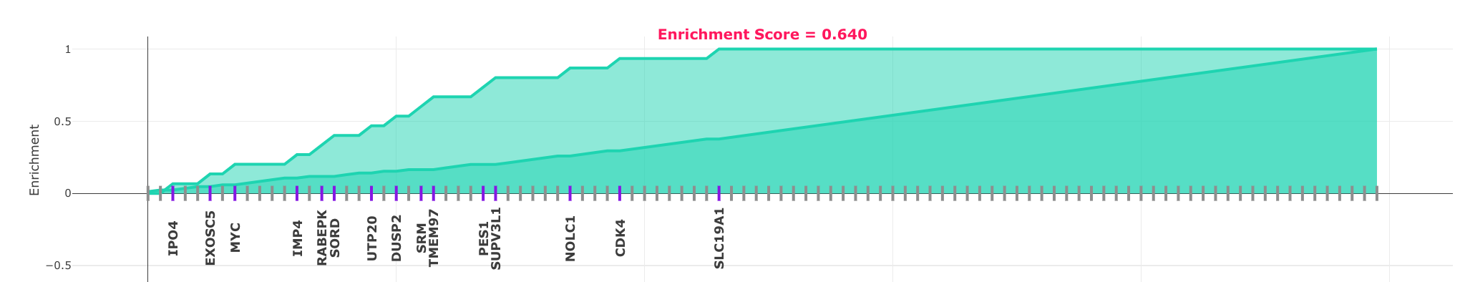
Estimating Enrichment by Quantifying the Difference in CDF Distributions
rank in sorted gene list h (1,...,N)
P_{i} PDF of genes in the set (weighted)
Q_{i} PDF of genes not in the set
Ranked Gene List
P_{i} CDF of genes in the set (weighted)
max difference
Q_{i} CDF of genes not in the set
Ranked Gene List
Gene Set
Enrichment Score = Max Difference between weighted CDF Distributions

Slide 22
GSEA Enrichment Plot
CDF of genes in the set (weighted) P_{i}
max difference
CDF of genes not in the set Q_{i}
Ranked Gene List
Gene Set
The Enrichment Plot Shows the Difference between the CDFs: P_{i} - Q_{i}
max difference

Slide 23
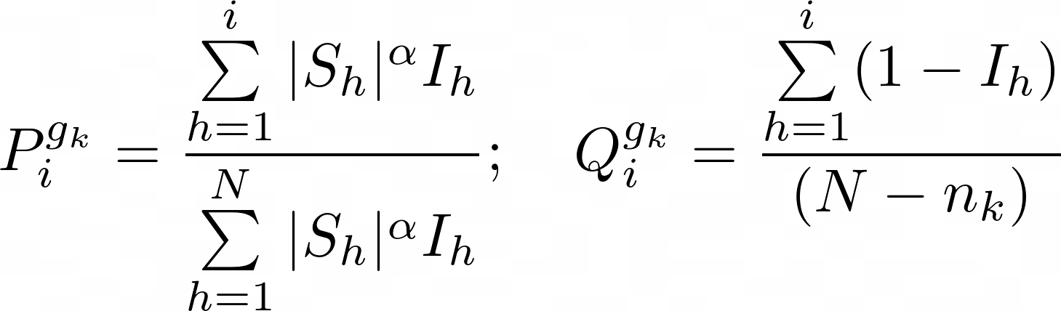
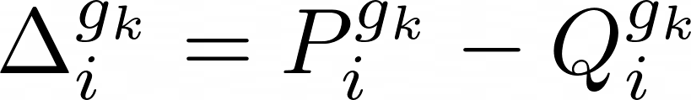
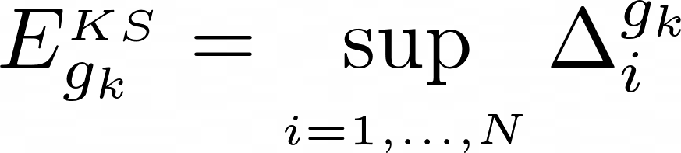
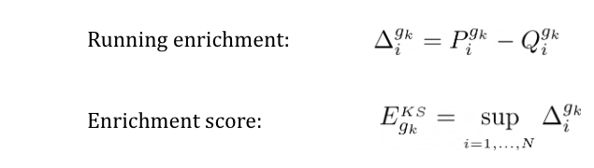
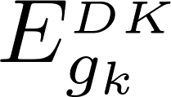
GSEA Enrichment Score
Weighted CDF of genes in the gene set (hits) CDF of genes not in the set (misses)
gene score at rank h
indicator function: 1 if gene is in the set and 0 if is not
hit
miss
size of gene set
total number of genes in gene list
Running score (height of enrichment plot)
Enrichment score is maximum difference
Kolmogorov-Smirnov Statistic
max difference = 0.640

Slide 24
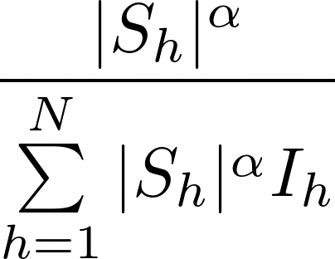
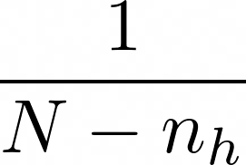
The Enrichment Score is the Max Difference between weighted CDF Distributions
The Enrichment Plot Shows the Difference between the CDF’s
Because the CDF’s start at zero and end at one, the enrichment plot starts at zero and ends at zero
Enrichment Score is quantified as the Max Difference between the weighted CDF’s Distributions (Kolmogorov-Smirnov Statistic)
Moving left to right:
Every time you encounter a hit (gene in the set) the score goes up by the gene score
Every time you encounter a miss (gene not in the set) gene the score goes down by one unit
Up
Down
max difference = 0.640
starts at zero
ends at zero

Slide 25
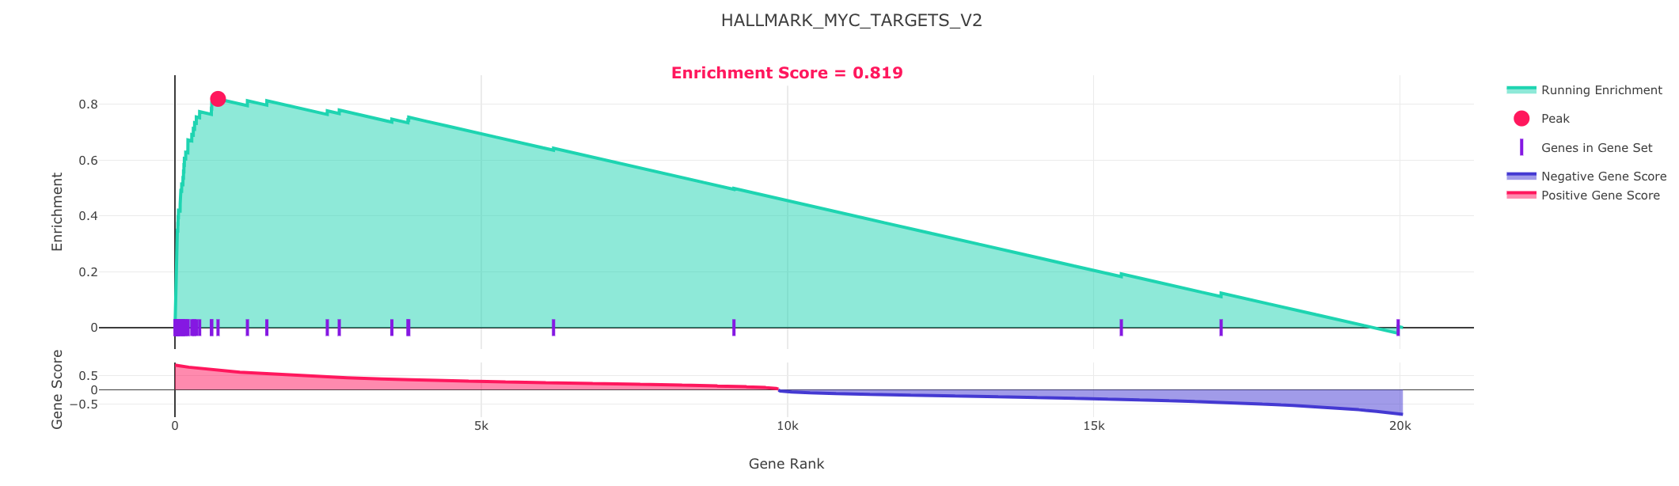
Same Example but Using the Full Gene List and Gene Set

Slide 26
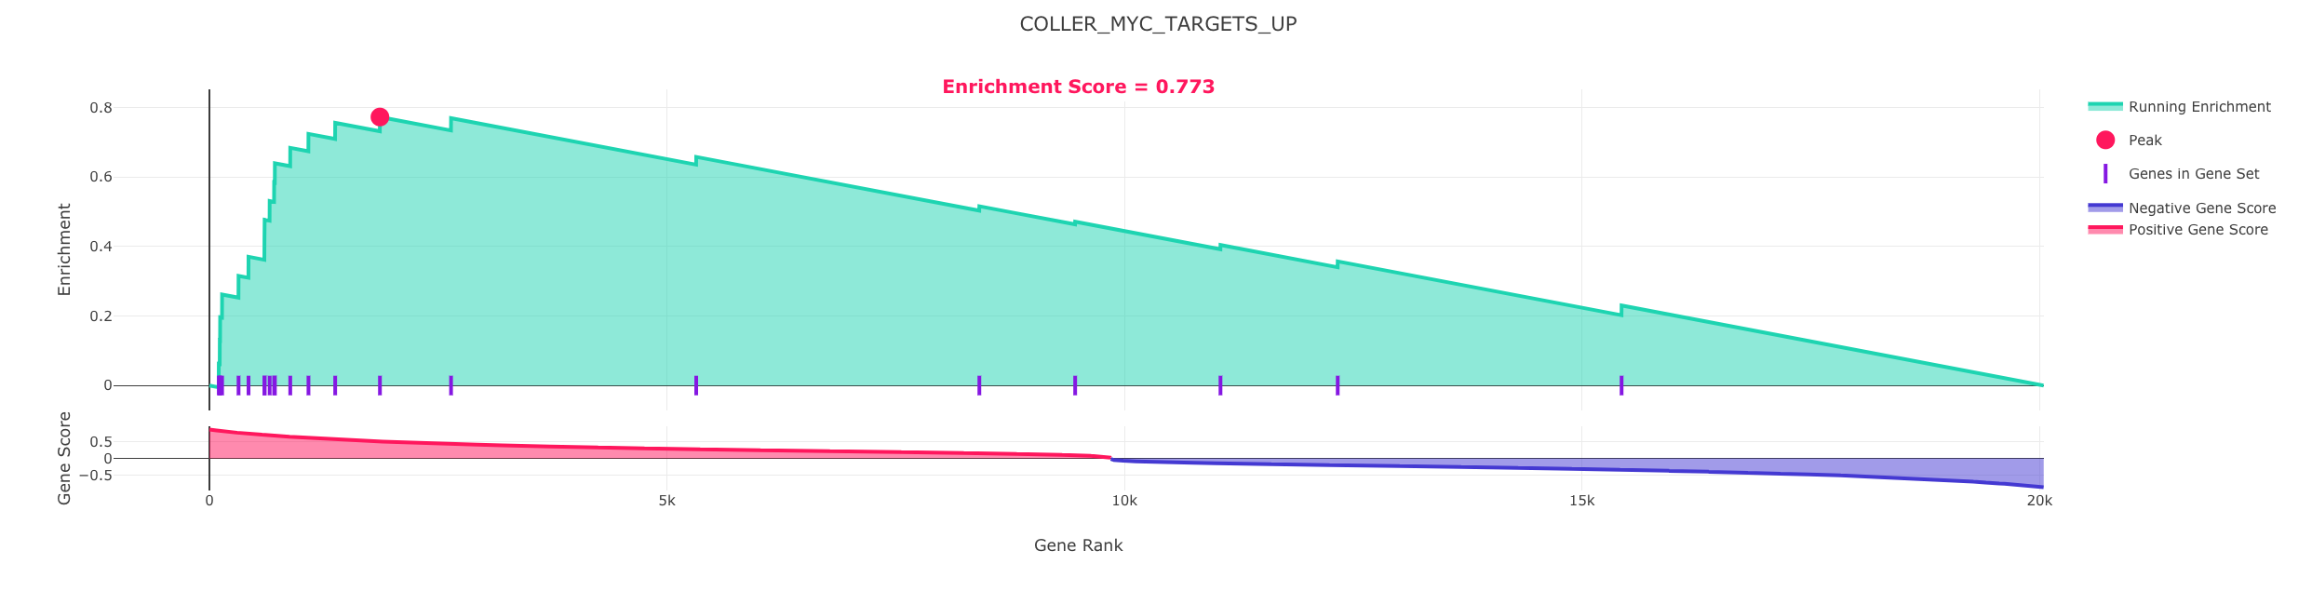
Another High Scoring MYC-related Gene Set

Slide 27
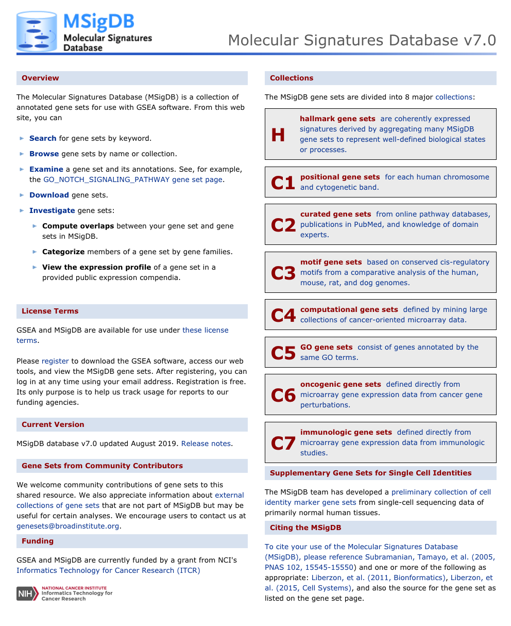
Gene Sets Database: MSigDB
msigdb.org

Slide 28
The Standard GSEA Algorithm is a Multiple-Stage Procedure
Gene ranking
This is typically achieved by performing Differential Gene Expression (DGE) Analysis to measures the degree of association between gene expression profiles and a phenotype.
Different types of ranking methods can be used. As part of the jupyter prototype we will use the Information Coefficient (IC, Kim et al. 2016) to rank genes.
Estimating the Degree of Gene Set Enrichment
An enrichment score is computed to assess the enrichment or over-representation of an independently defined gene set at the top or bottom of the ranked list.
Assessing Statistical Significance
This includes generating an empirical permutation test plus a procedure to estimate False Discovery Rates (FDR) and a final sorted gene set enrichment result set and plots of high-scoring gene sets.

Slide 29
Modalities of Use

Slide 30
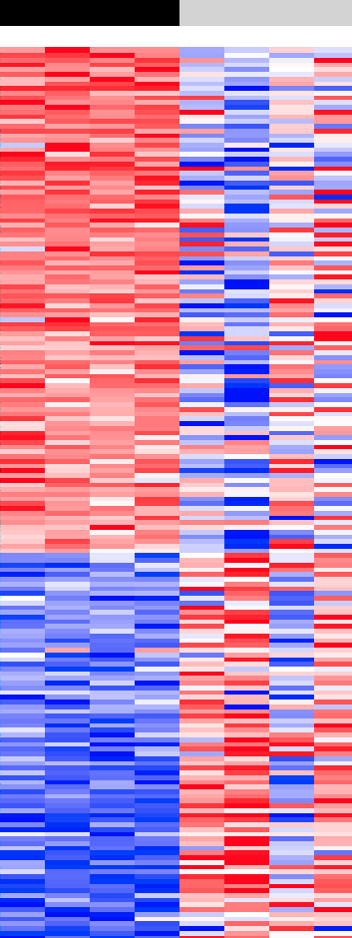
The Standard GSEA Method
Standard GSEA
Outer loop over many gene sets (gene set database e.g. MSigDB)
Permutation Test to Assess Statistical Significance of results
Summary Report for top scoring gene sets and plots
Expression Dataset & Phenotype
Gene Sets
Gene Ranking
Sample or gene permutation test loop
GSEA
Enrichment
Statistics
Report and Plots

Slide 31
Common Application Modalities of GSEA Analysis
Standard GSEA
Single-Sample
GSEA
Pre-Ranked GSEA
Set Overlap GSEA
Expression Dataset & Phenotype
Expression Dataset & Phenotype
Pre-ranked Profile
Gene Set vs. Database of Gene Sets
Gene Sets
Gene Sets
Gene Sets
Gene Ranking
Normalization
Core GSEA
Enrichment
Set Overlap
Loop over
samples
loop over sets
Sample permutation test loop
Gene permutation test loop
Statistics
Core GSEA
Enrichment
Core GSEA
Enrichment
Statistics
Report and Plots
Gene Set Ranking
Report and Plots
Statistics
Sample permutation
test loop
Report and Plots
Statistics
Report and Plots

Slide 32
The Future

Slide 33
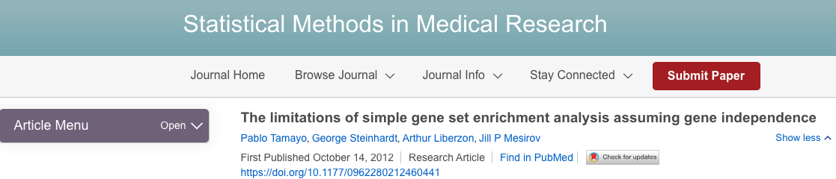

Slide 34
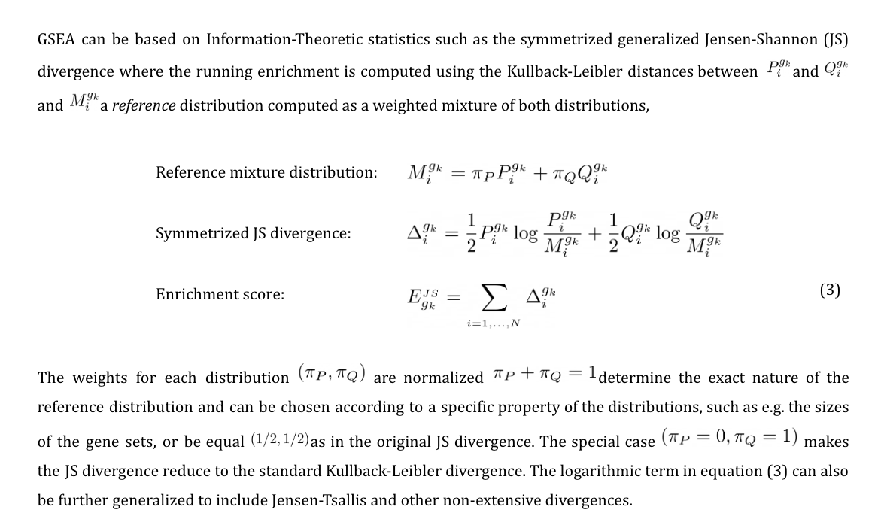

Slide 35
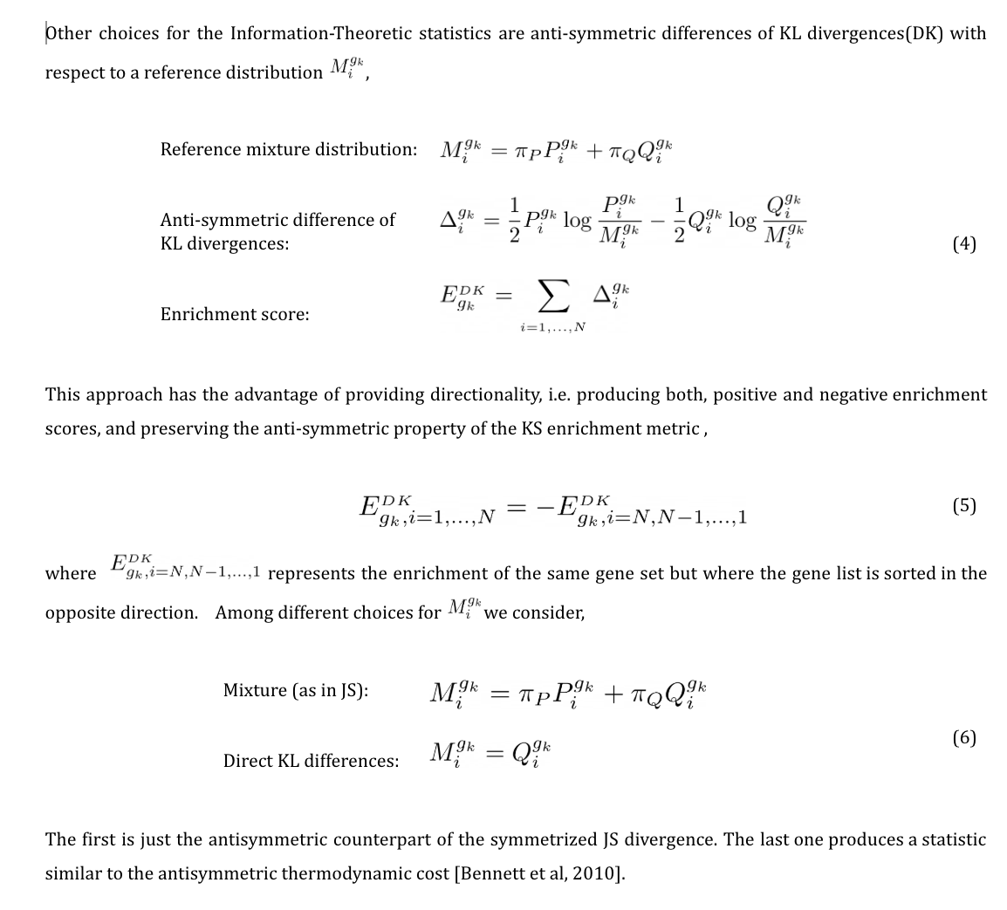

Slide 36
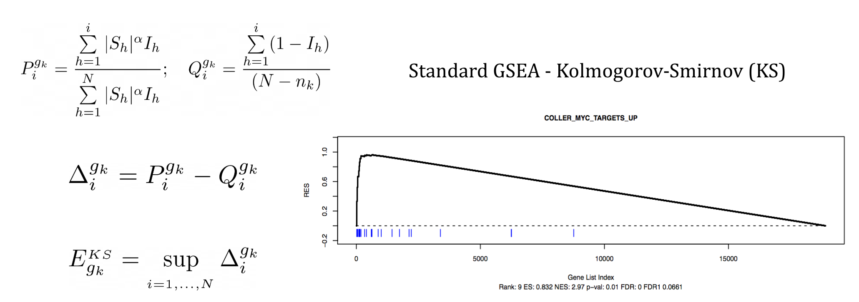
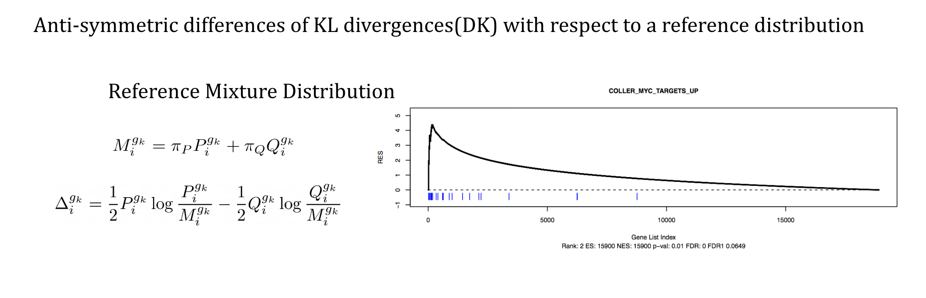

Slide 37

Now that you are ready unleash the power of GSEA

Slide 38

Bring out your inner LD when planning and running GSEA

Slide 39
In other words, be critical!

Slide 40
Do’s and don’ts when planning for an experiment
Don’t do it because you can – do it because it is necessary.
Do know your objective/goal/hypothesis.
Don’t plan complex experiments.
Do minimize confounders (e.g. batch, context, time points etc.).
Do have look for positive and negative control, just like with any experiments.
When in doubt, do consult people with experience interpreting.

Slide 41

Do’s and don’ts when planning for an experiment
Don’t do it because you can – do it because it is necessary.
Do know your objective/goal/hypothesis.
Don’t plan complex experiments.
Do minimize confounders (e.g. batch, context, time points etc.).
Do have look for positive and negative control, just like with any experiments.
When in doubt, do consult people with experience interpreting.

Slide 42
Do’s and don’ts when planning for an experiment
Don’t do it because you can – do it because it is necessary.
Do know your objective/goal/hypothesis.
Don’t plan complex experiments.
Do minimize confounders (e.g. batch, context, time points etc.).
Do have look for positive and negative control, just like with any experiments.
When in doubt, do consult people with experience interpreting.

Slide 43
Do’s and don’ts when planning for an experiment
Don’t do it because you can – do it because it is necessary.
Do know your objective/goal/hypothesis.
Don’t plan complex experiments.
Do minimize confounders (e.g. batch, context, time points etc.).
Do have look for positive and negative control, just like with any experiments.
When in doubt, do consult people with experience interpreting.

Slide 44
Do’s and don’ts when planning for an experiment
Don’t do it because you can – do it because it is necessary.
Do know your objective/goal/hypothesis.
Don’t plan complex experiments.
Do minimize confounders (e.g. batch, context, time points etc.).
Do have look for positive and negative control, just like with any experiments.
When in doubt, do consult people with experience interpreting.

Slide 45
Do’s and don’ts when planning for an experiment
Don’t do it because you can – do it because it is necessary.
Do know your objective/goal/hypothesis.
Don’t plan complex experiments.
Do minimize confounders (e.g. batch, context, time points etc.).
Do have look for positive and negative control, just like with any experiments.
When in doubt, do consult people with experience interpreting.

Slide 46

Experimental considerations
What phenotype?
Experimental condition
of interest
Pathway Activation (e.g. ORFs, CRISPRa)
CRISPR knockout (e.g. CRISPR, CRISPRi)
Differentiation status
Mutant vs. wild-type isogenic
GEMMs / metabolic treatment
Specific cell population (e.g. Flow sorting)
…
Phenotype
A
Phenotype
B
How many replicates ?
Up-regulated
Individual genes
Pathways
TF regulators
Phenotypes
Right cut-off?
Which gene set class?
Down-regulated
Gene expression

Slide 47
Getting most out of GSEA
GSEA can be a hypothesis generating tool, or proof-of-concept – either way, always validate.
Multiple gene sets are always better than one.
Multiple types of gene sets are even better.
Not all gene sets are created equal - some are better than others.
Context matters
Always go back to the original paper describing the gene set to understand the context and the experiment.
Create your own gene sets.

Slide 48




Slide 49
Getting most out of GSEA
GSEA can be a hypothesis generating tool, or proof-of-concept – either way, always validate.
Multiple gene sets are always better than one.
Multiple types of gene sets are even better.
Not all gene sets are created equal - some are better than others.
Context matters
Always go back to the original paper describing the gene set to understand the context and the experiment.
Create your own gene sets.

Slide 50



Slide 51
Getting most out of GSEA
GSEA can be a hypothesis generating tool, or proof-of-concept – either way, always validate.
Multiple gene sets are always better than one.
Multiple types of gene sets are even better.
Not all gene sets are created equal - some are better than others.
Context matters
Always go back to the original paper describing the gene set to understand the context and the experiment.
Create your own gene sets.

Slide 52
Generating “clean” oncogenic pathway readouts using isogenic systems
Oncogene
Ctrl
Overexpress oncogene
Knock-down/out tumor suppressors
Up-regulated
Down-regulated
Gene expression

Slide 53

Generating “clean” readouts of MYC pathway
MYC
Ctrl
Up-regulated
No change
Down-regulated
Gene expression

Slide 54

GSEA of MYC isogenic profiles finds many MYC gene sets

Slide 55

Gene sets from different sources give more confidence to the results

Slide 56
Global patterns can emerge with clean experimental results

Slide 57

Validation of the findings

Slide 58




Slide 59
Getting most out of GSEA
GSEA can be a hypothesis generating tool, or proof-of-concept – either way, always validate.
Multiple gene sets are always better than one.
Multiple types of gene sets are even better.
Not all gene sets are created equal - some are better than others.
Context matters
Always go back to the original paper describing the gene set to understand the context and the experiment.
Create your own gene sets.

Slide 60
Not all gene sets are created equal - some are better than others.
If expected gene sets do not match with your phenotype, don’t panic – although, being constantly curated, quality of some gene sets are simply not very good.
Some biological processes / pathways are underrepresented.
Solution: find and make your own gene sets (literature, GEO database)

Slide 61
Not all gene sets are created equal - some are better than others.
If expected gene sets do not match with your phenotype, don’t panic – although, being constantly curated, quality of some gene sets are simply not very good.
Some biological processes / pathways are underrepresented.
Solution: find and make your own gene sets (literature, GEO database)
Just because gene sets do not agree with your study, doesn’t immediately make it a bad gene set - context also matters!

Slide 62


Context matters!
KRAS ^{G12V}
Ctrl
Lung
Skin
Breast
Primary
…
Gene expression
Gene expression
Gene expression
Gene expression

Slide 63



Slide 64


Up-regulated
Down-regulated

Slide 65





Slide 66
Getting most out of GSEA
GSEA can be a hypothesis generating tool, or proof-of-concept – either way, always validate.
Multiple gene sets are always better than one.
Multiple types of gene sets are even better.
Not all gene sets are created equal - some are better than others.
Context matters
Always go back to the original paper describing the gene set to understand the context and the experiment.
Create your own gene sets.

Slide 67

Getting most out of GSEA

Slide 68
Getting most out of GSEA
GSEA can be a hypothesis generating tool, or proof-of-concept – either way, always validate.
Multiple gene sets are always better than one.
Multiple types of gene sets are even better.
Not all gene sets are created equal - some are better than others.
Context matters
Always go back to the original paper describing the gene set to understand the context and the experiment.
Create your own gene sets.

Slide 69

Your experiments can be gene sets which can translate into phenotypes
Oncogene
Ctrl
Pathway activation
Continuous
Phenotypic score
ssGSEA
High
Low
Gene expression

Slide 70




Slide 71


Matching your phenotype to many other phenotypes
B-catenin Pathway Score

Slide 72

A well-curated gene set in the MsigDB Is Worth many In The literature
Your well validated
gene set

Slide 73
A well-curated gene set in the MsigDB Is Worth many In The literature
Your well validated
gene set
v8.0
…
v80.0
Keep evolving for
The biomedical community

Slide 74
Questions?

